Slide 1

FidMark: A Fiducial Marker Ontology For Semantically Describing Visual Markers
Maxim Van de Wynckel, Isaac Valadez, Beat Signer

Slide 2
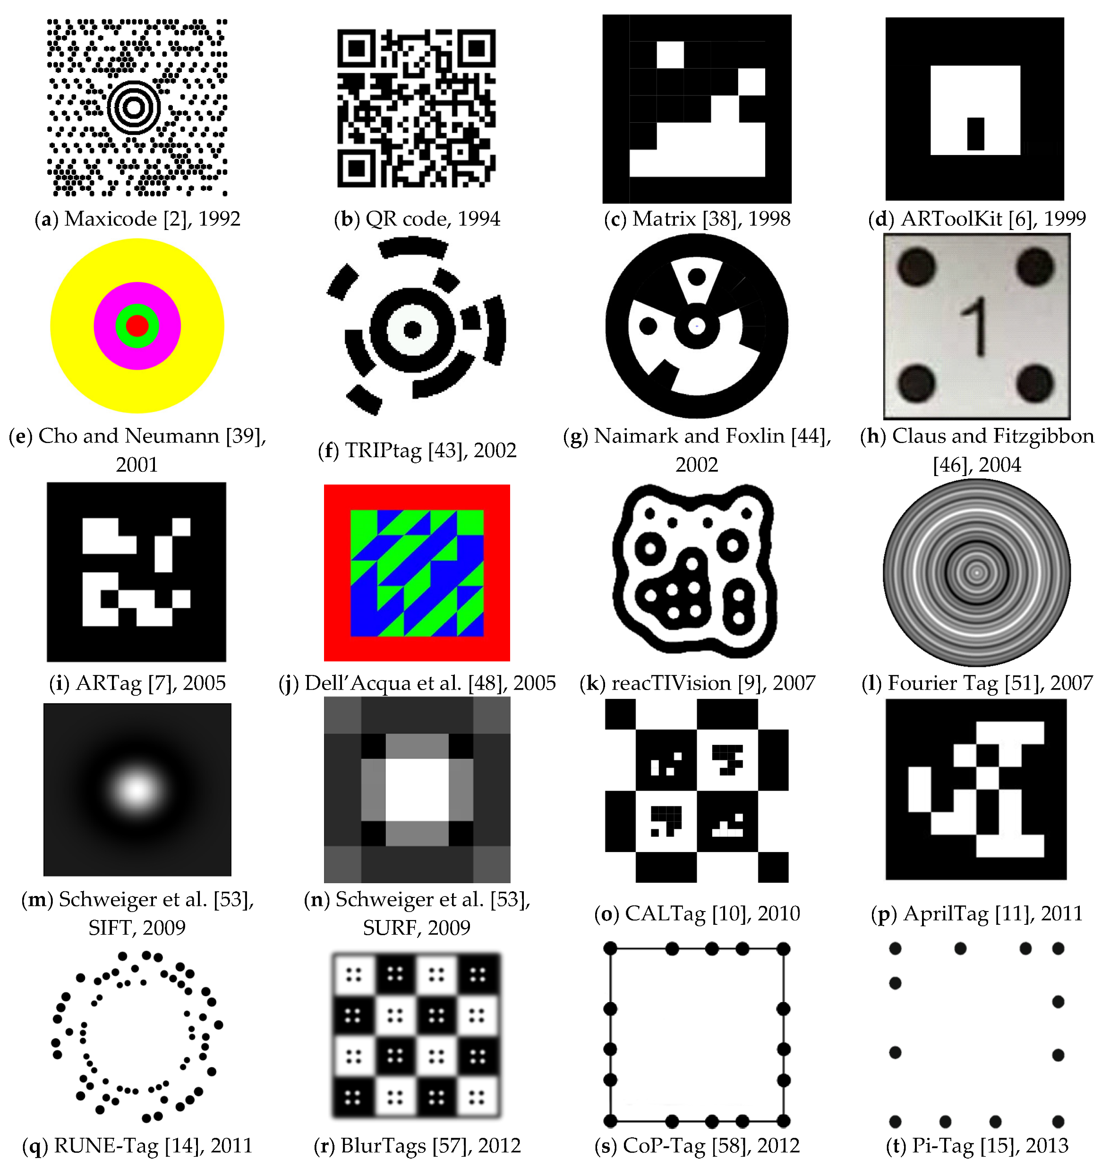
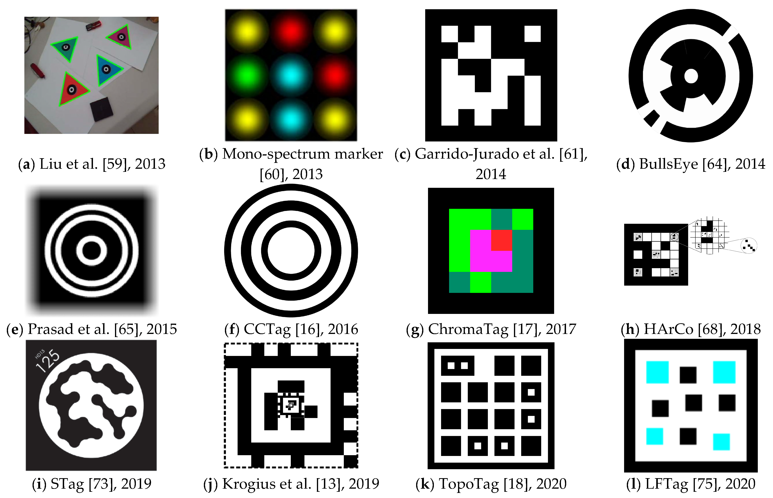
Background – Fiducial Marker
Košťák, M.; Slabý, A. Designing a Simple Fiducial Marker for Localization in Spatial Scenes Using Neural Networks. Sensors 2021, 21, 5407. https://doi.org/10.3390/s21165407

Slide 3
Design Goals
DG1 Retrieve a list of supported markers
DG2 Retrieve markers using the identifiable information
DG3 Describe markers with a non-standard symbology
DG4 Enable pose estimation of markers
DG5 Enable relative positioning of objects to markers
DG6 Enable markers as engineering reference frames
DG7 Facilitate the integration in CV frameworks

Slide 4
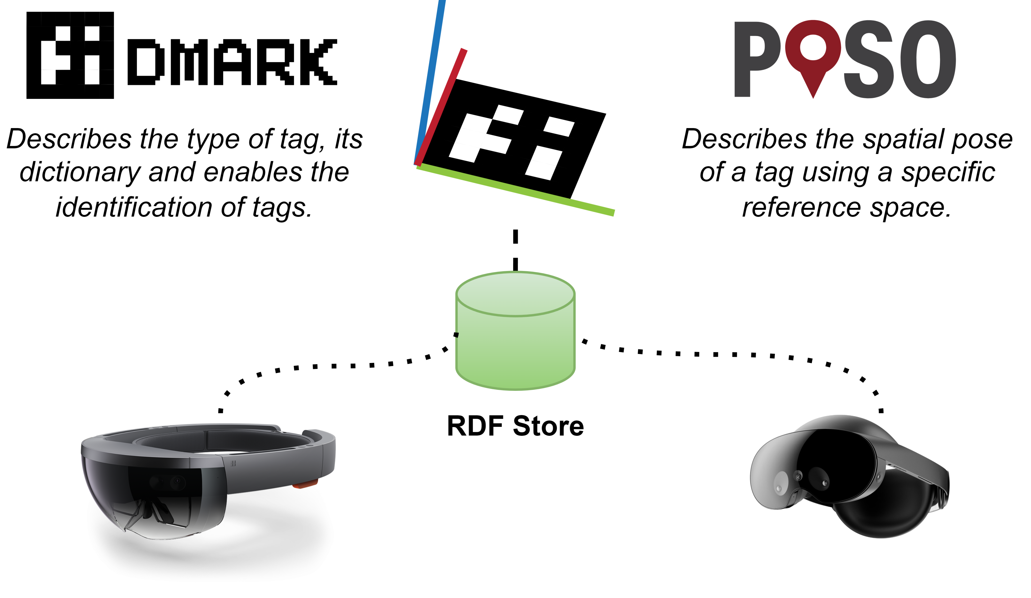
Ontology Design

Slide 5
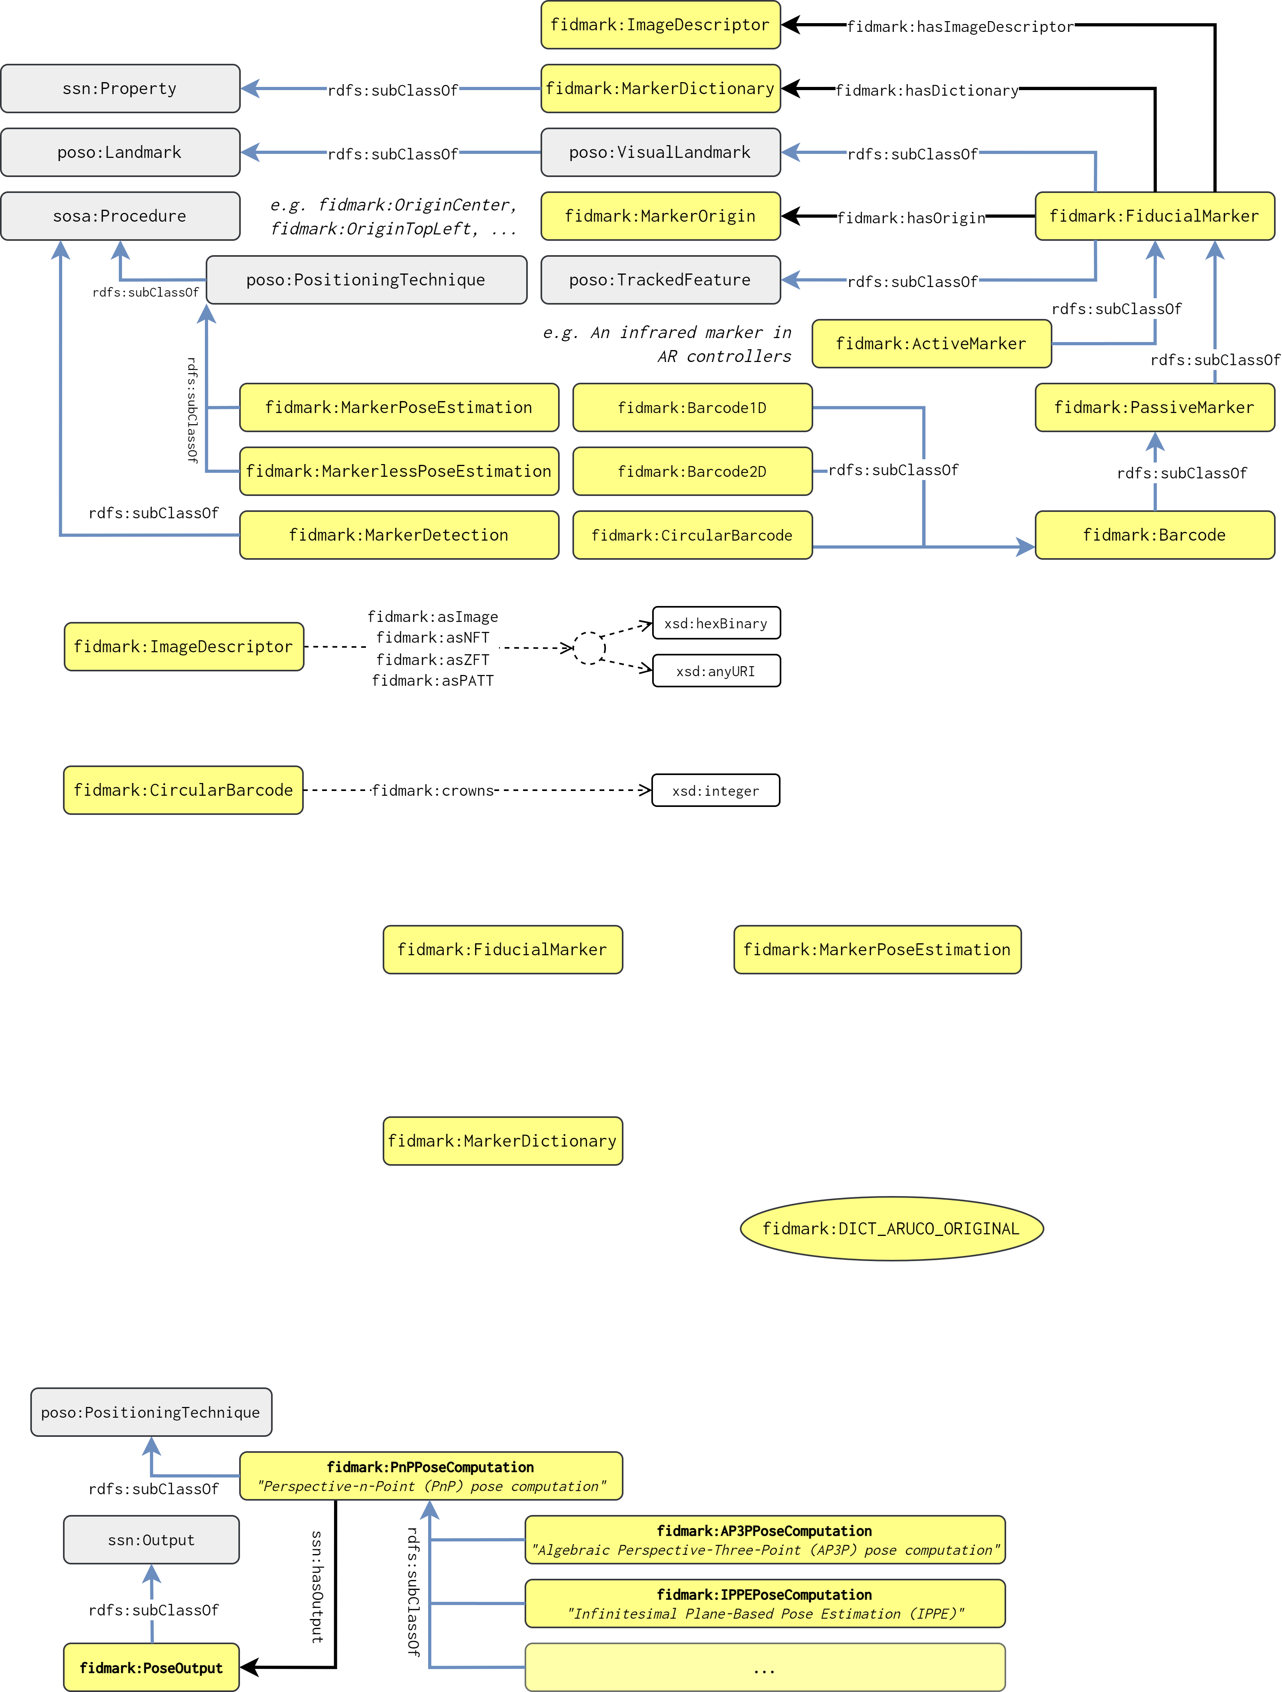
Ontology Design

Slide 6
Ontology Design

Slide 7
Validation
OOPS! Validator (OntOlogy Pitfall Scanner)
SPARQL queries for design goals
Demonstator Web application

Slide 8
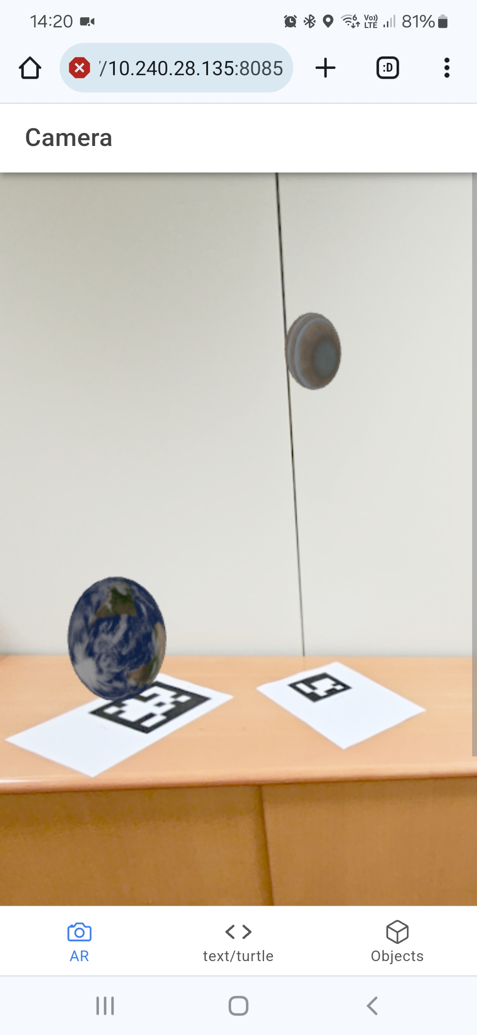
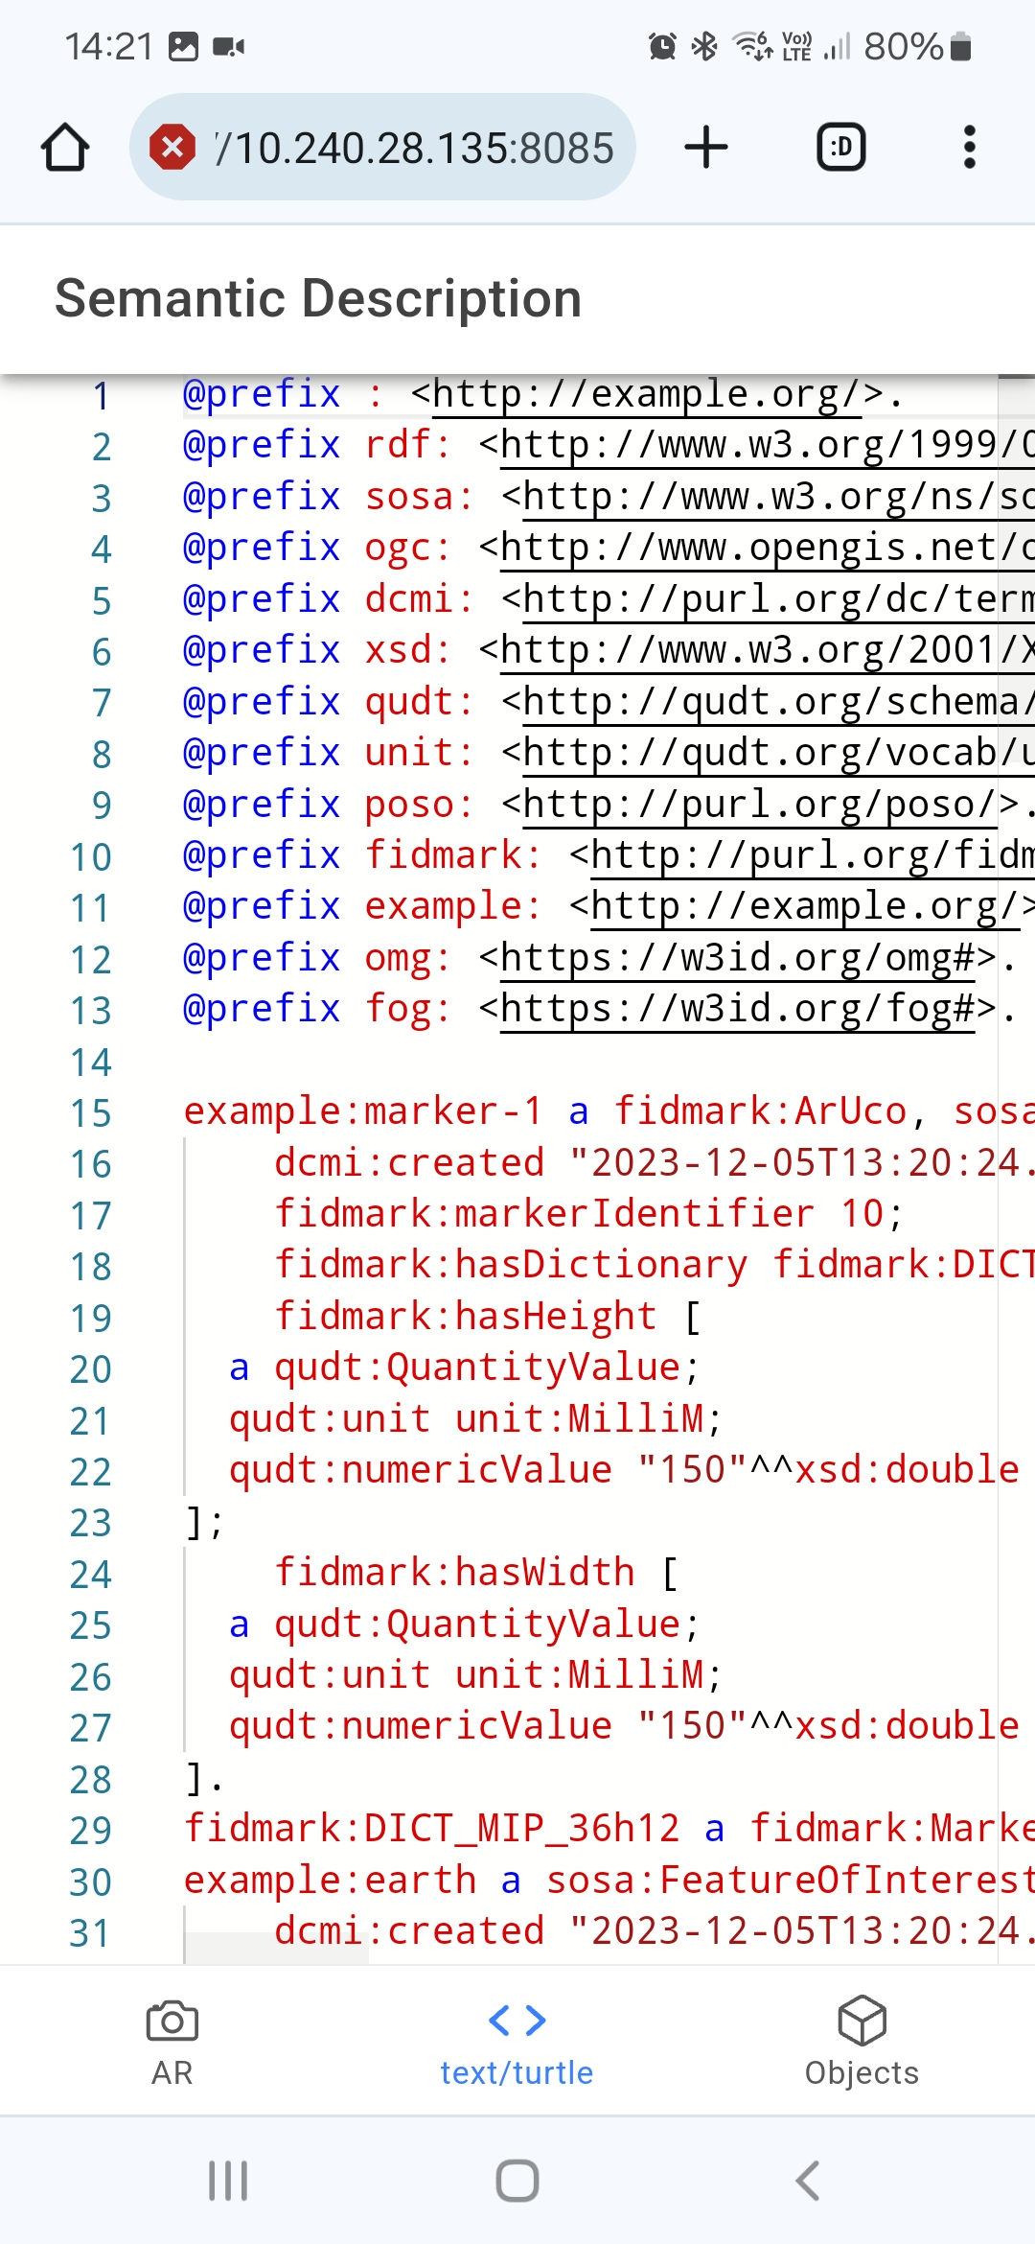
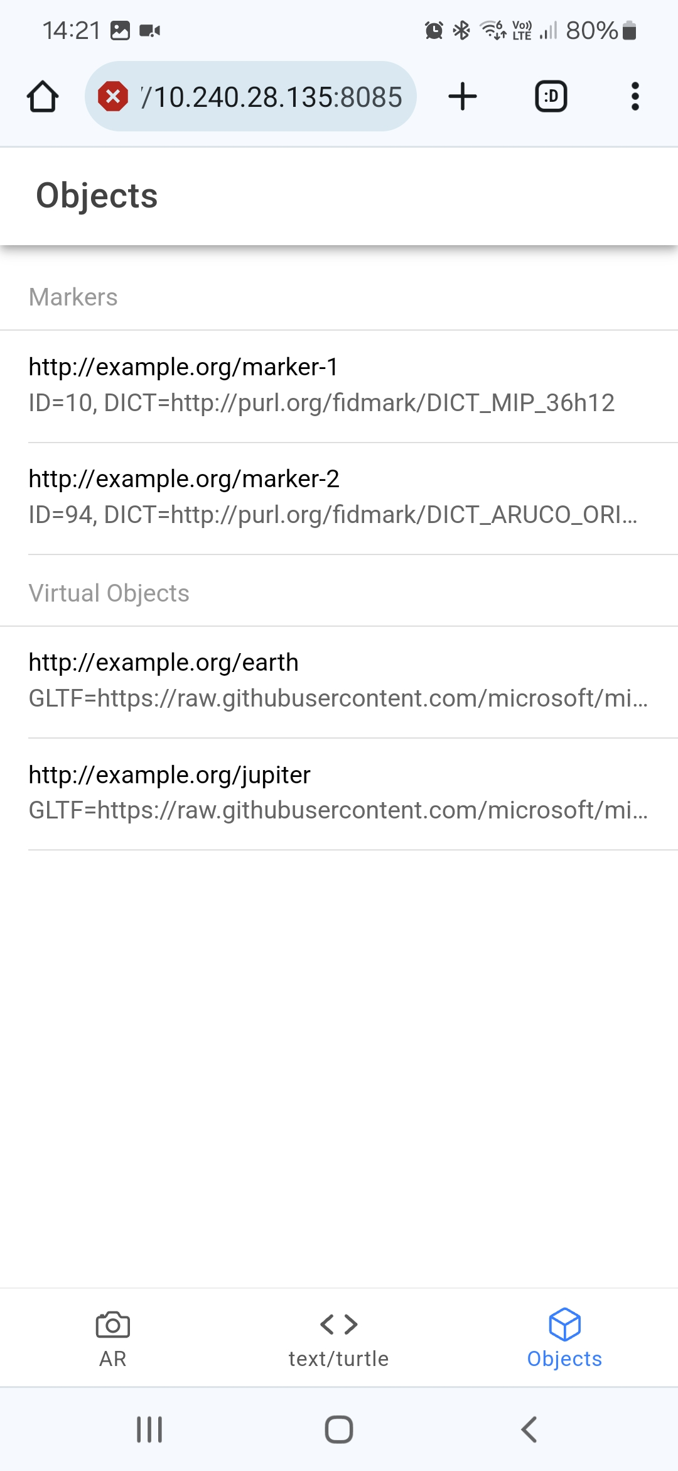
Demonstrator

Slide 9
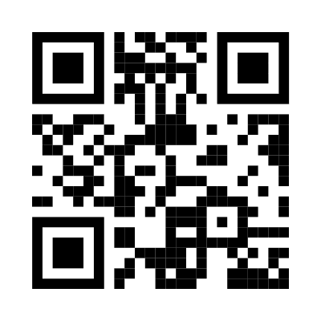


Conclusions and Future Work
Fiducial marker ontology with a focus on Augmented Reality
Demonstrator application
https://purl.org/fidmark/
https://fidmark.openhps.org/
https://github.com/OpenHPS/FidMark/

